Slide 1



Slide 2
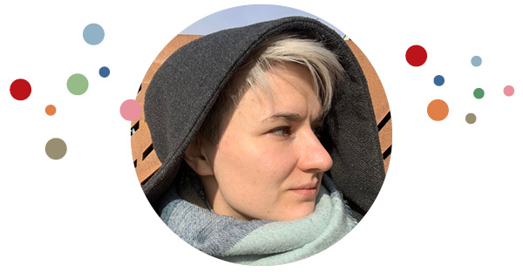
Welcome everyone!
January
2020
June
2020
There’s is a reason behind everything we do…
Milda Latakaitė

Slide 3
Master class - Co-Facilitation
A Short Agenda
1. Start
2. Connecting with self as Facilitator
3. Connecting with relationships through role of a Facilitator
4. What can we do more?
5. Further possibilities to grow
6. Closure

Slide 4
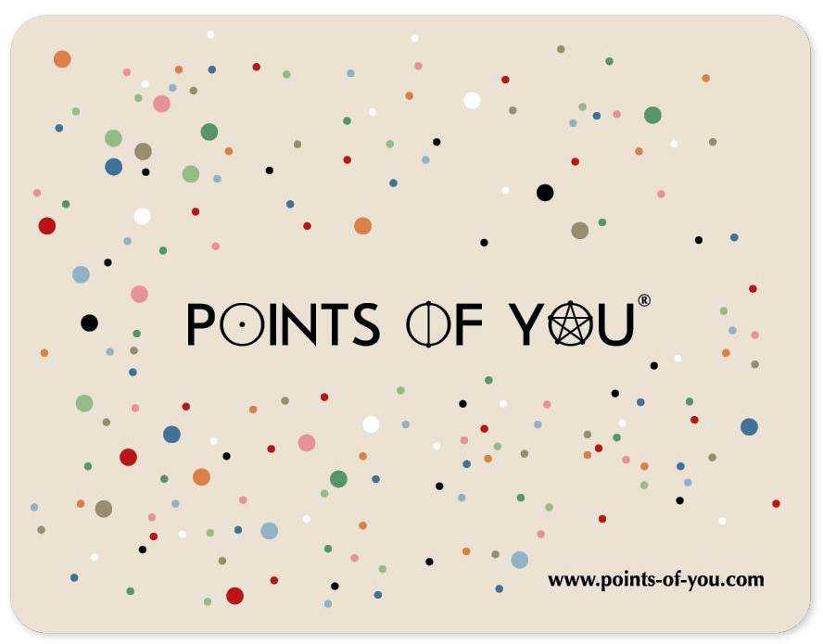
Master class - Co-Facilitation
Pick Faces card that connect with you most towards you as Facilitator.
Be curious for a beginning.
Why this one?
What is so special about it?
How does it connect with you?
Than.. Take a sheet of paper, a pen and lets start focusing on our personal integrity with Me as Facilitator

Slide 5
Master class - Co-Facilitation
My integrity.
How am I making and keeping commitments with self? What am I standing for?
My Intent.
What are my motives of being a facilitator? What is my way of declaring my intent? Am I abundant? How could I bring more of it?
My Capabilities.
What are my strengths? What is my purpose as facilitator? How am I keeping myself relevant sand not slipping away? Where am I going with my path?
My Results.
What results am I achieving? Am I taking enough responsibility for these? From 1 to 10 – how strong am I in this one?

Slide 6
Breakout groups of 3.
15 min
1. Introduce self shortly
2. Share discoveries
3. Ensure that everyone shines
Notes:
Introduce yourself

Slide 7
Me as Facilitator in Co – Facilitation Relationships
Am I balancing myself here or am I extreme in one or another direction?
Reflection based on Stephen M.R. Covey “Speed of Trust Relationships level
Notes:
Introduce yourself

Slide 8
Master class - Co-Facilitation
1. Talking Straight.
Being honest, telling truth. Letting people know where you stand. Using simple language, calling things what they are, demonstrating integrity.
2. Demonstrating Respect.
Genuinely caring for others. Treating everyone in respect, especially those who can’t do anything for you. Showing kindness in little things.
3. Creating Transparency.
Telling truth in a way people can verify, declaring your intent, being open and authentic. Also being transparent about not being able to be transparent.
4. Right wrongs.
Making things right when you are wrong. Apologizing quickly, demonstrating humility. Not allowing pride to get in the way of doing the right thing.
5. Show loyalty.
Giving credit to others, speaking about people if they were present.

Slide 9
Master class - Co-Facilitation
6. Delivering results.
Establishing a track record of results, not over promising and under delivering. Not creating excuses for not delivering.
7. Getting better.
Continuously improving, being a constant learner. Acting on a feedback that was received.
8. Confront reality.
Confronting issues before they turn into major problems. Confronting reality not a person.
9. Clarifying expectations.
Disclosing and revealing expectations. Nod violating expectation and not assuming that expectations are clear and shared.
10. Practising accountability.
Holding self accountable first and than holding others accountable second. Taking responsibility for results good or bad.

Slide 10
Master class - Co-Facilitation
11. Listening first.
Listening before you speak. Understand. Diagnose. Listen with your ears, eyes and heart.
12. Keep Commitments.
Continuously improving, being a constant learner. Acting on a feedback that was received.
13. Extending Trust.
Confronting issues before they turn into major problems. Confronting reality not a person.

Slide 11
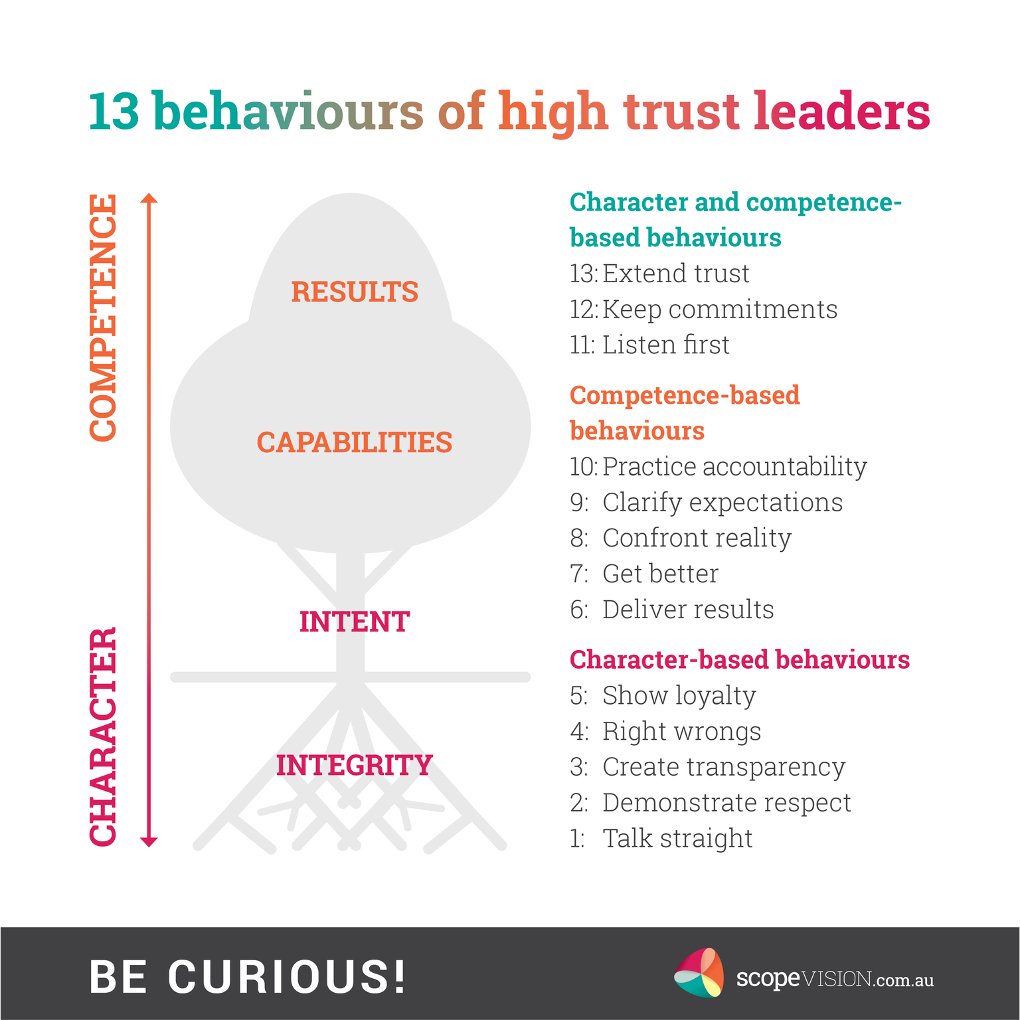

Slide 12
What could we do even more to create our experiences, relationships stronger?
Doing so that our Co-s would be open hearted, connecting, truthful and filled with learning and growth?
Doing it so we are serving participants with No Ego <3
PARENT,
LEADER,
CONTAINER
(Live vs Virtual experiences keeping in mind)

Slide 13

Our individual impact based on book “Speed of Trust”

Slide 14
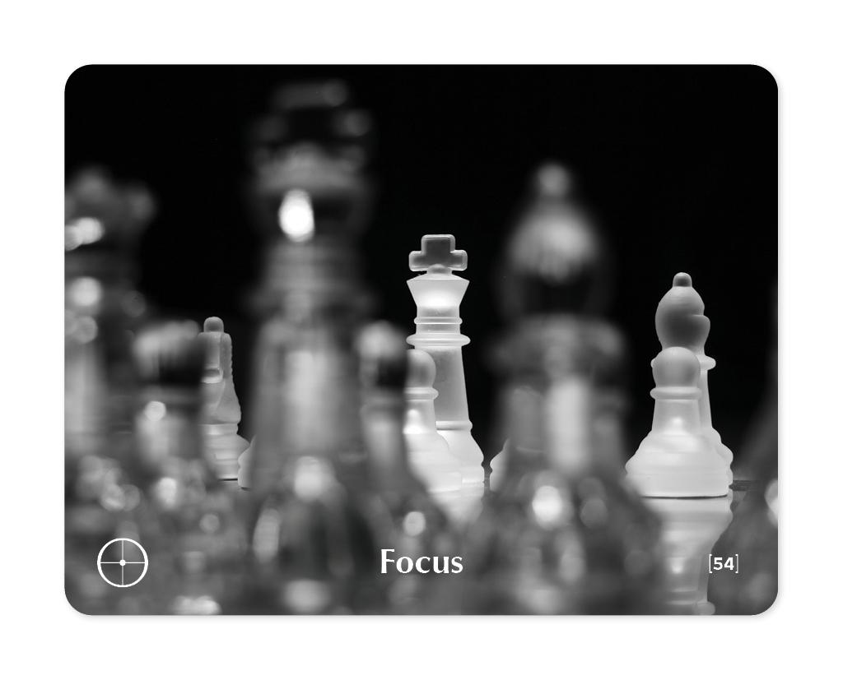
Search for your significant insight
What are my main insights from this Master Class?
How can I use my discovery to uplift mine and my peer co-facilitation experiences?

Slide 15
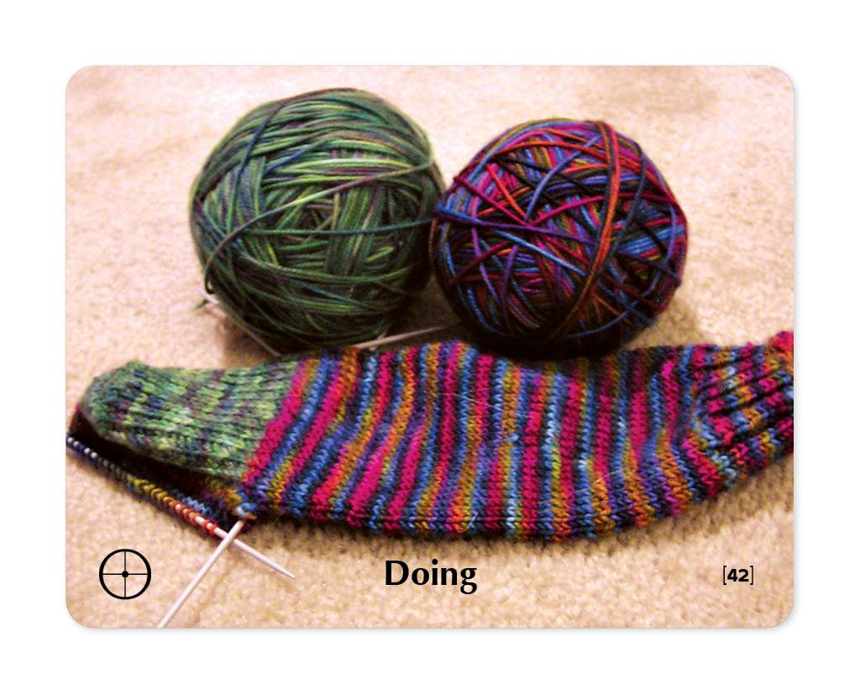
Turn your insight into actions
How will I bring my insight into my everyday life?
What simple actions will I take in:
The next 24 hours
The next 7 days
The next 30 days

Slide 16
What am I taking away with me?
In one word maximum one sentence :)

